Slide 1
COMP 1017
Styling Forms

Slide 2
Marking up our forms is one thing, but without a little CSS, our forms can look a little … lacking.

Slide 3
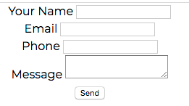

Slide 4
Let’s give it some style.

Slide 5
Form Styles
Forms with added pizzazz.

Slide 6
In our .psd, it looks like all of our <input> elements have the same styling.

Slide 7
Let’s target it.

Slide 8
<form id="contact-form" action="" method="POST">
<label for="name">Your Name</label>
<input id="name" type="text" name="name" />
</form>
--
input {
/** CSS goes here - go through your psd to find out which CSS declarations you will use. **/
}

Slide 9
When you’re finished styling your <input>, it should look something like this …

Slide 10
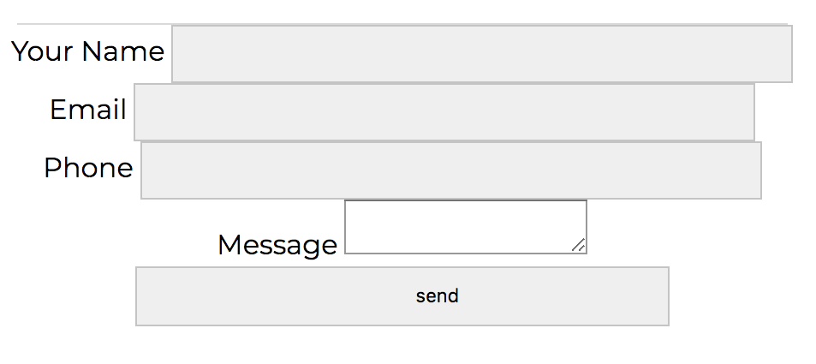

Slide 11
Our submit button looks a lot like the other input fields. We probably want to differentiate it somehow.

Slide 12
Fortunately, we can target it with a class or its type attribute.

Slide 13
<form id="contact-form" action="" method="POST">
<div class="name">
<label for="name">Your Name</label>
<input id="name" type="text" name="name" />
</div>
</form>
--
div.submit-button input {
/** CSS goes here **/
}

Slide 14
<form id="contact-form" action="" method="POST">
<div class="name">
<label for="name">Your Name</label>
<input id="name" type="text" name="name" />
</div>
</form>
--
input[type=text] {
/** CSS goes here **/
}

Slide 15
Now, what about our <textarea>?

Slide 16
By default, a <textarea> is both horizontally and vertically expandable.

Slide 17
We can change those by using the property resize or by adding min and max width or height to the <textarea>.

Slide 18
resize has the following values:
both | horizontal | vertical | none | inherit

Slide 19
Taking everything we just learned, let’s finish that exercise!

